Slide 1
OOPM PROJECT
INFINITE RUNNER GAME

Slide 2
PROBLEM STATEMENT
To implement an Infinite Runner Game in Java involving a main character that would be controlled by the user, some obstacles and a scoreboard.

Slide 3
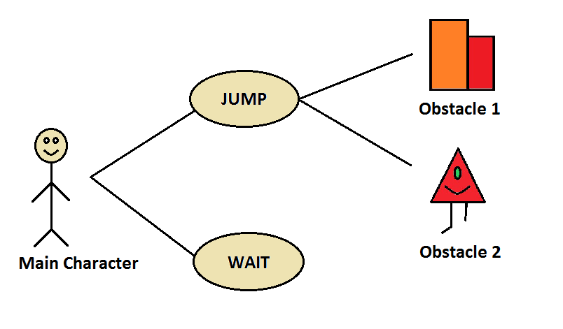
USE CASE DIAGRAM

Slide 4
CLASS DIAGRAM
public class Game
int k = 0; | Animation devil; | Sprite evil; | void main (String[]) | void draw (Graphics)
int m = 1; | Animation thing; | Sprite bock; | void loadPics() | void update (long)
long time; | Animation back; | Sprite bockn; | void run() | void Jump()
long score; | ScreenManager s1; | Image pic6; | void restore() | void keyPressed (KeyEvent)
boolean running = true; | Sprite sprite; | Image pic7; | void movieLoop() | void keyReleased (KeyEvent)
Animation hero; | Sprite rod; | DisplayMode modes1[]; | void type (DisplayMode) | void keyTyped (KeyEvent)

Slide 5
public class Animation
ArrayList scenes; | void addScene(Image , long)
int sceneIndex; | void start()
long movieTime; | void update(long)
long totalTime; | Image getImage()
Animation() | OneScene getScene(int)

Slide 6
public class ScreenManager
GraphicsDevice vc; | DisplayMode findFirstMode(DisplayMode[]) | void setFullScreen(DisplayMode) | int getW()
JFrame f; | DisplayMode getCurrMode() | Graphics2D getGraphics() | int getH()
ScreenManager() | boolean displayModesMatch(DisplayMode,DisplayMode) | void update() | void restoreScreen()
DisplayMode[] getCompatibleDisplayModes() | JFrame getFrame() | Window getFullScreenWindow() | BufferedImage createImage(int, int, int)

Slide 7
public class Sprite
Animation a; | void update(long) | int getH()
float x; | float getx() | float getdx()
float y; | float gety() | float getdy()
float dx; | void setx (float) | void setdx (float)
float dy; | void sety (float) | void setdy (float)
Sprite(Animation) | int getW() | Image getsImage()

Slide 8
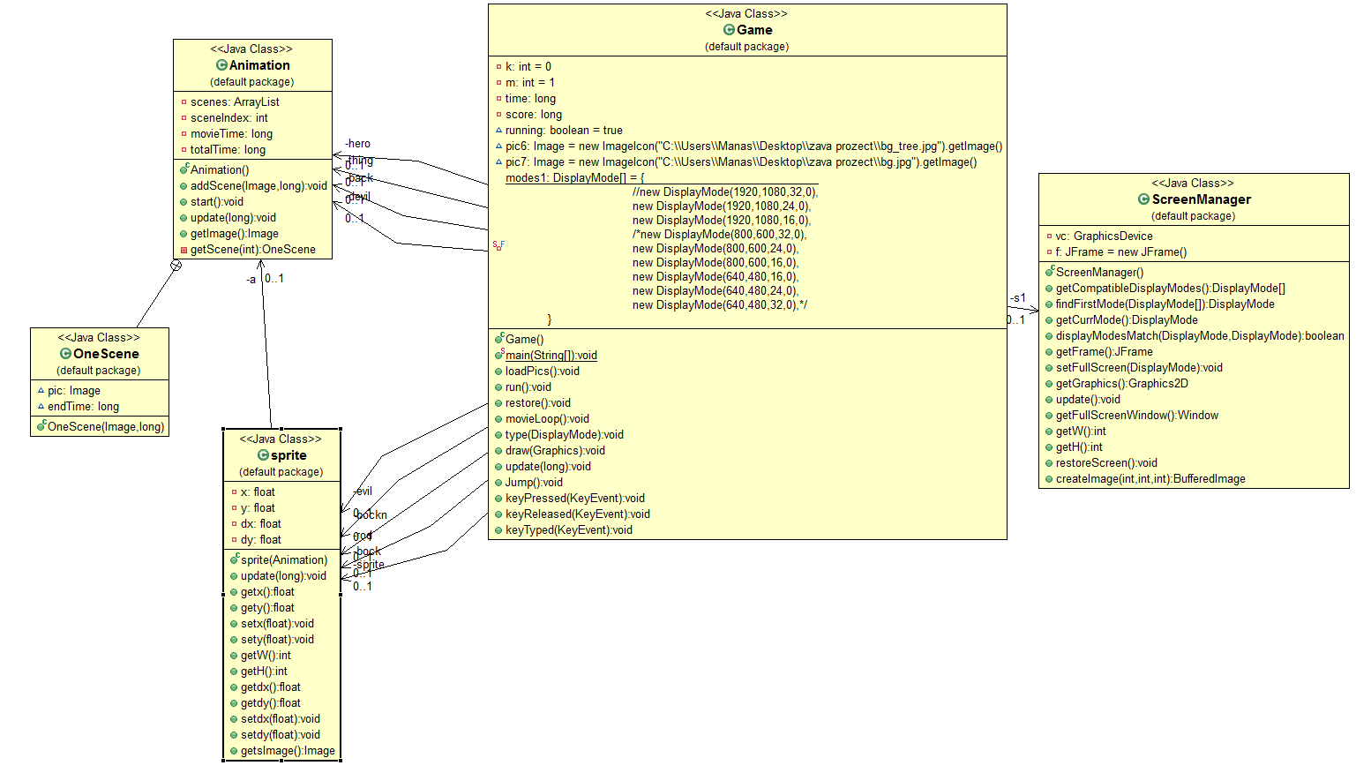
CLASS DIAGRAM

Slide 9
MAJOR JAVA FEATURES USED
Abstract Window Toolkit (AWT)
Swing
Interface
Event Handling

Slide 10
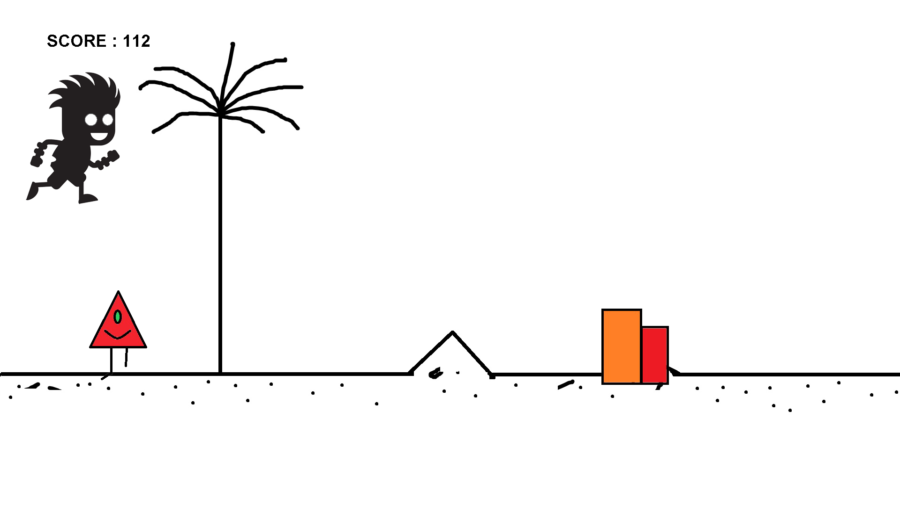
SCREENSHOTS

Slide 11
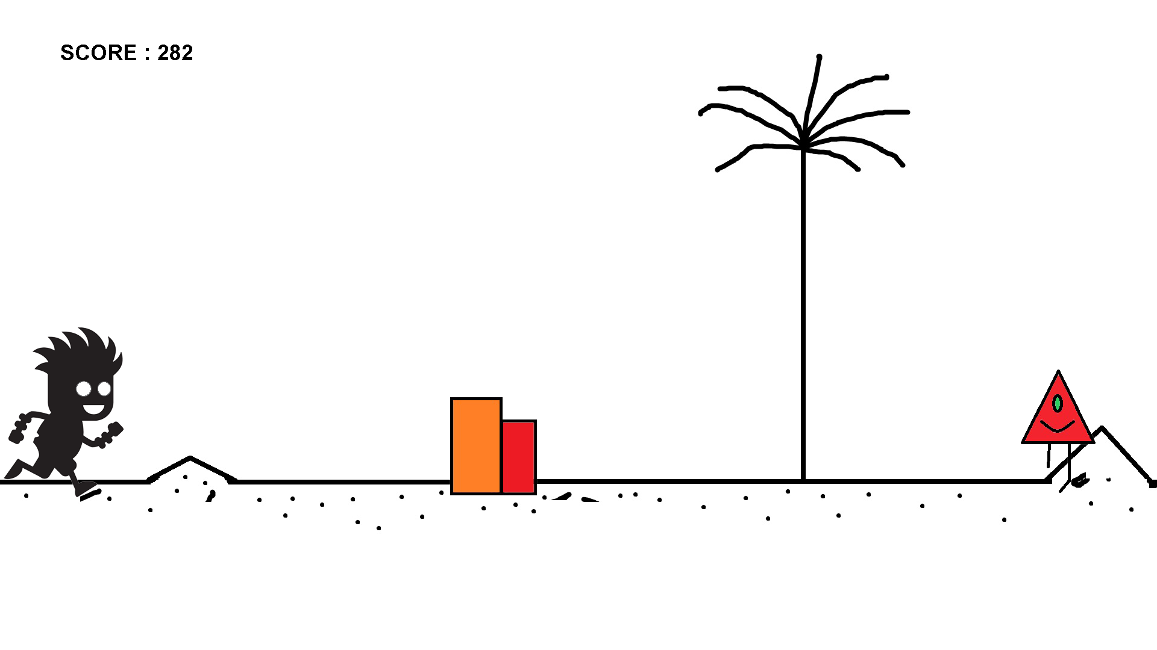

Slide 12
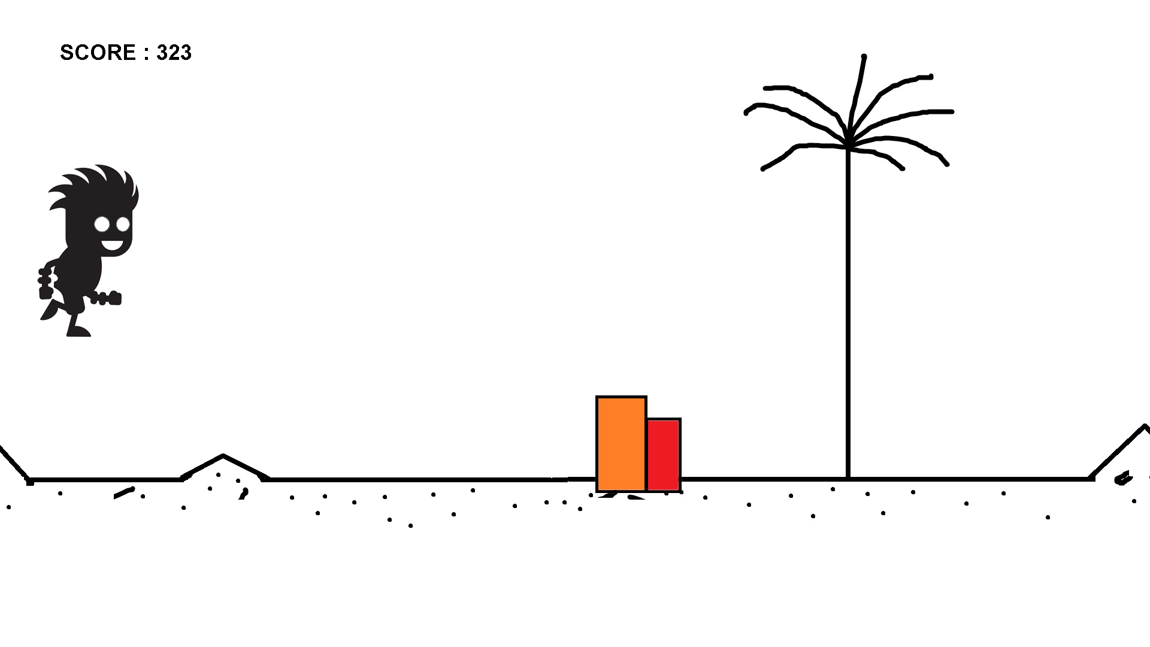

Slide 13
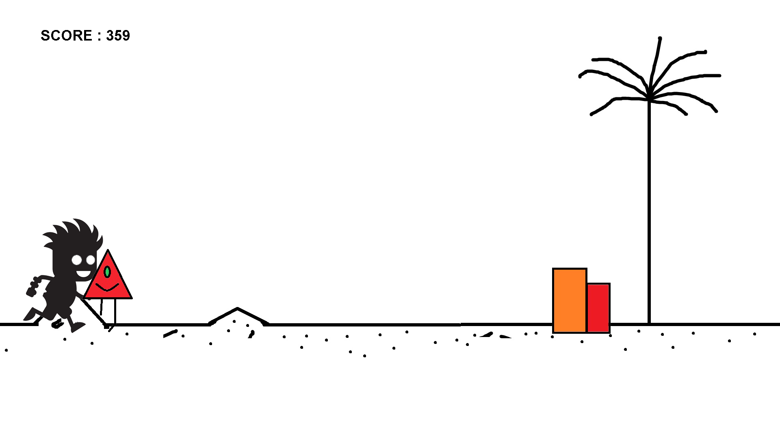

Slide 14
